Slide 1
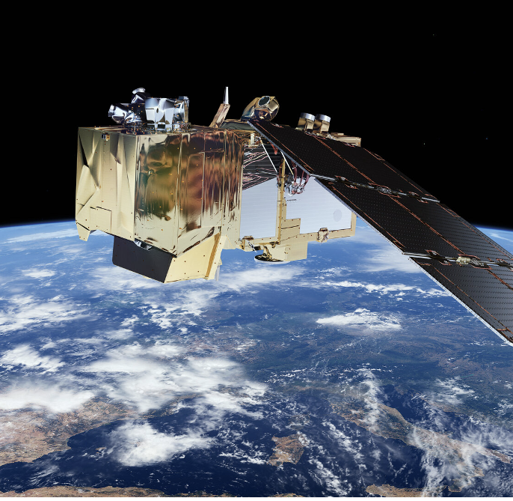
From pixels to planning: Foundation models in urban analytics
Barbara Metzler – 21/011/24
bmetzler@turing.ac.uk

Slide 2
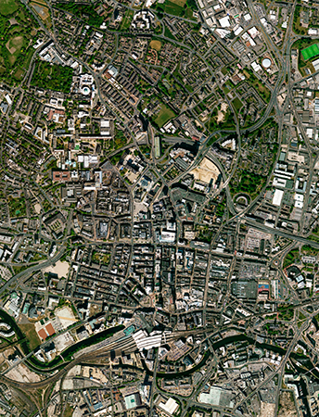
EO data are growing
- More and more satellites
Notes:
Sat images
Not so labour and time intensive: one datasource
Flexible
Multiple points in time (every 10 days sentinel2)
All locations
FREEE/

Slide 3
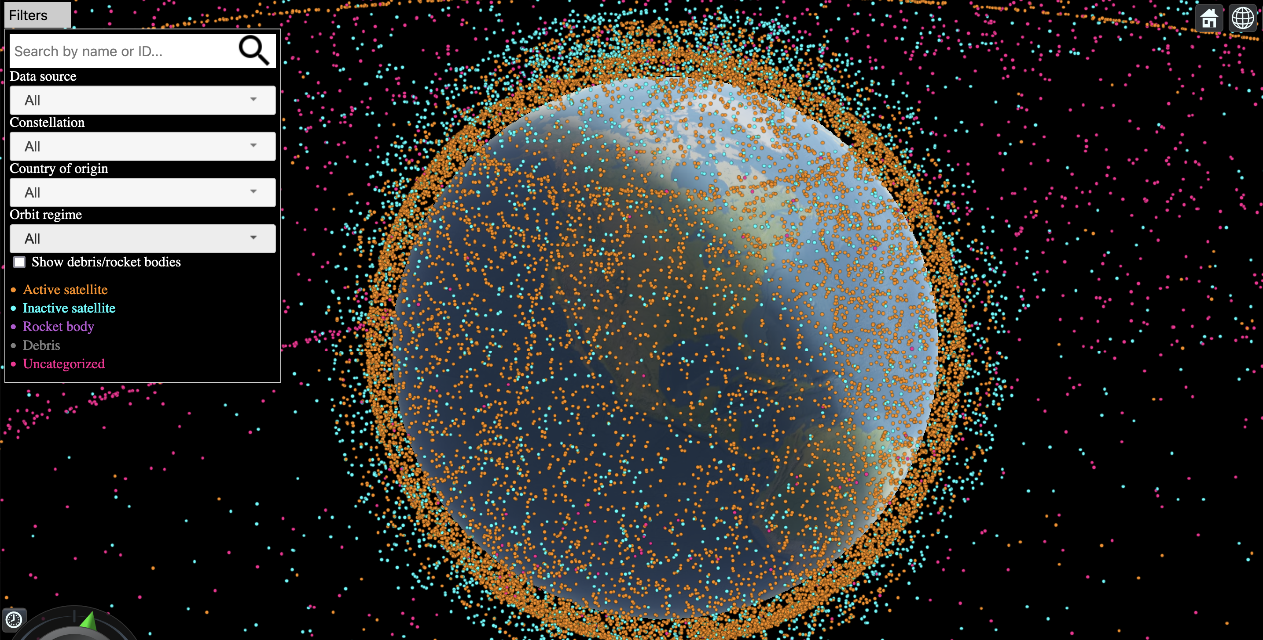
EO data are growing
- More and more satellites
http://astria.tacc.utexas.edu/AstriaGraph/
Notes:
Sat images
Not so labour and time intensive: one datasource
Flexible
Multiple points in time (every 10 days sentinel2)
All locations
FREEE/
10k satellite

Slide 4
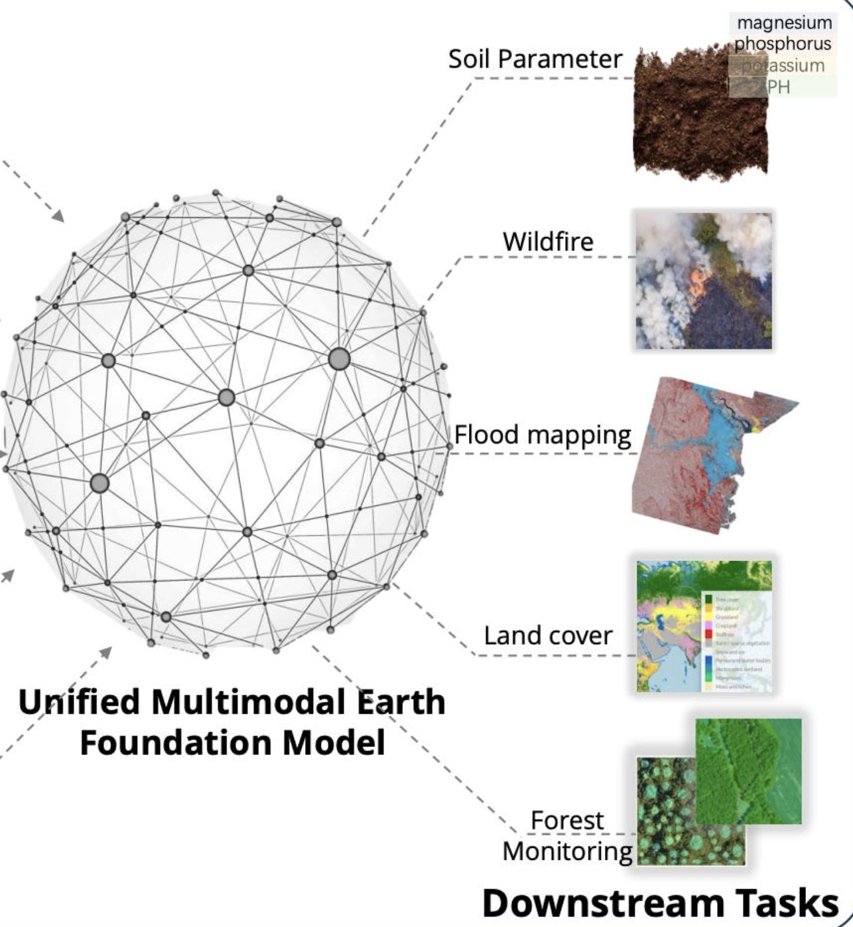
Developments in AI
Foundation models (~2020)
Soil parameter
Wildfire
Flood mapping
FM
Land cover
Forest monitoring
Downstream tasks

Slide 5
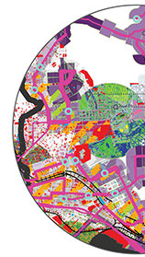
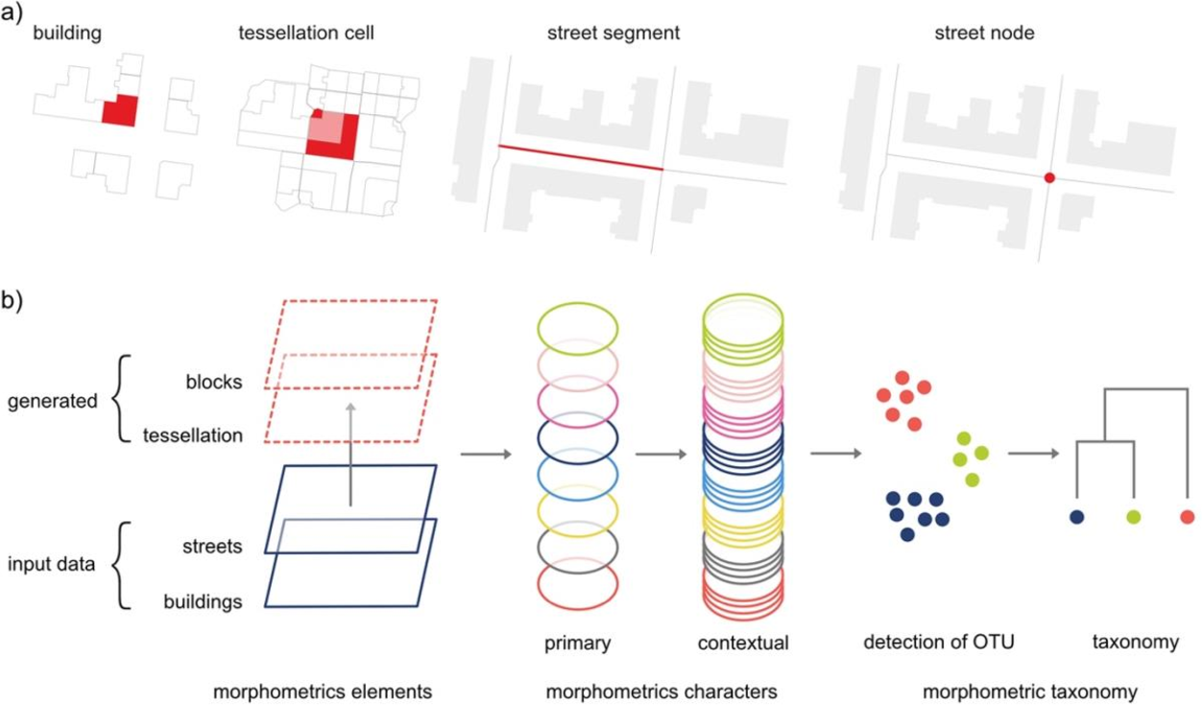
Cities are complex
So many ways of measuring a city
A lot of data!

Slide 6
Cities are complex
Large interest in using data/AI for urban decision making
More data → better models?

Slide 7
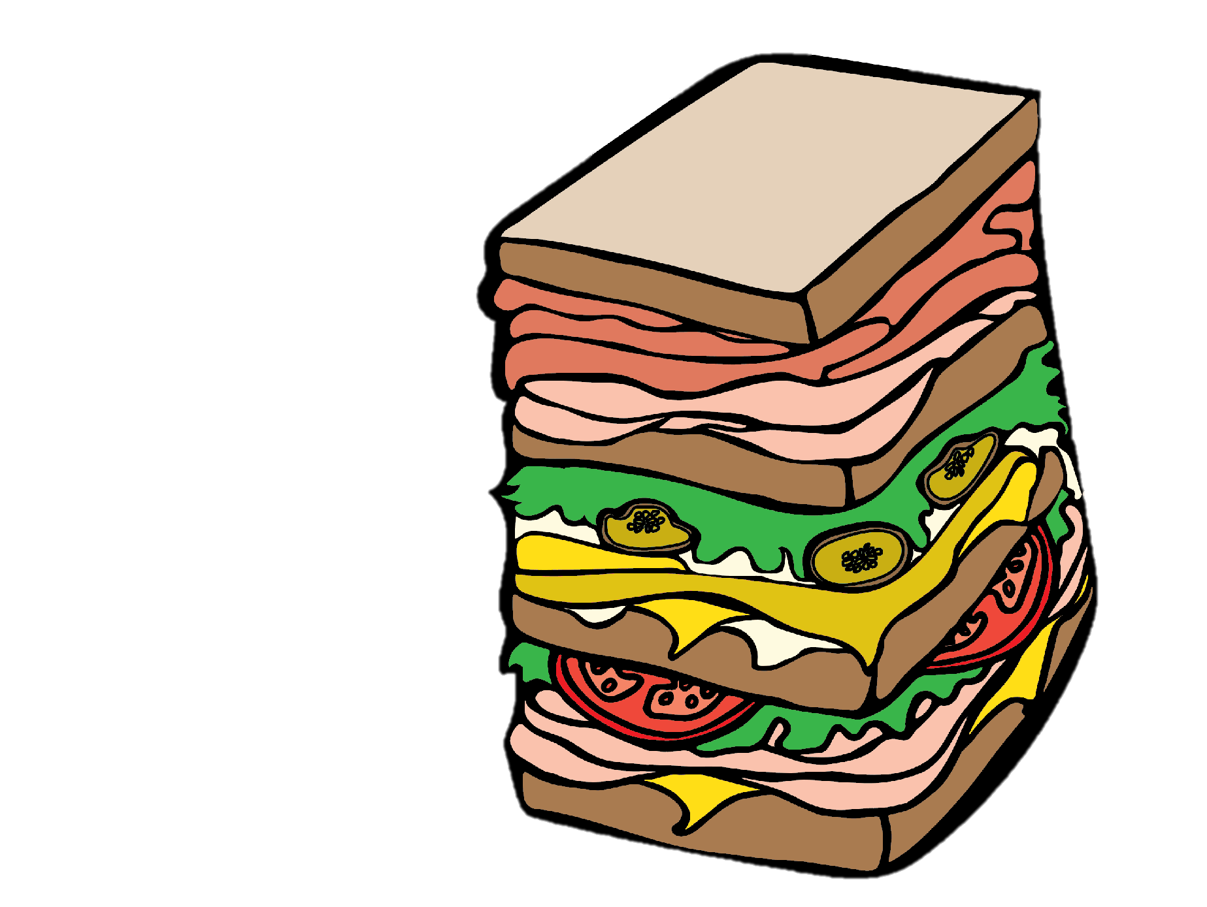
Cities are complex
Large interest in using data/AI for urban decision making
More data → better models?
Notes:
Data sandwich
Esp in ML this idea of more is more!

Slide 8
Is a (satellite) image worth a thousand data points?
Deep learning in combination with remote sensing data allows for new ways of studying cities.
Notes:
Sat images
Not so labour and time intensive: one datasource
Flexible
Multiple points in time (every 10 days sentinel2)
All locations
FREEE/

Slide 9
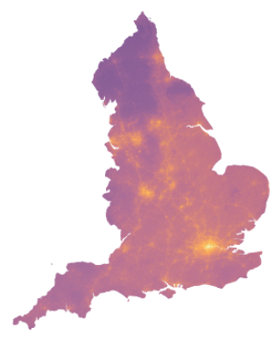
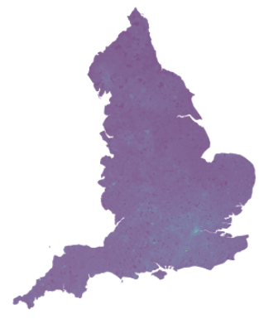
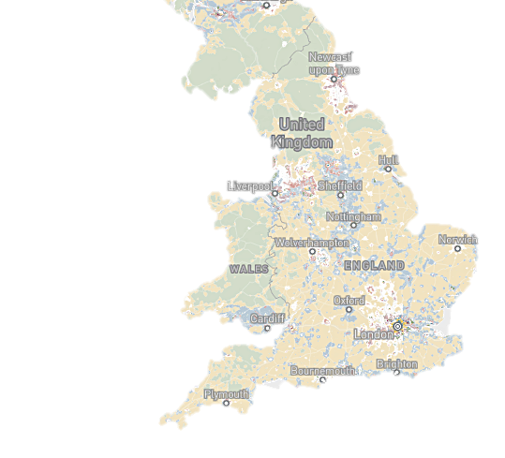
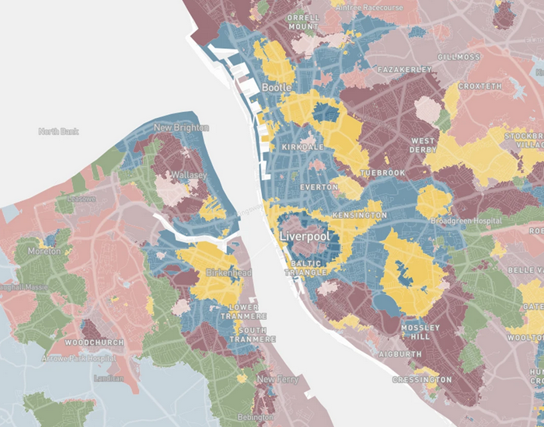
Urban applications across England
Air pollution
House prices
Spatial signatures
Fleischmann and Arribas-Bel. "Geographical characterisation of British urban form and function using the spatial signatures framework." Scientific Data 9.1 (2022): 546.

Slide 10
Urban applications across England
Air pollution
House prices
Spatial signatures
Part 1
Part 2
Fleischmann and Arribas-Bel. "Geographical characterisation of British urban form and function using the spatial signatures framework." Scientific Data 9.1 (2022): 546.

Slide 11
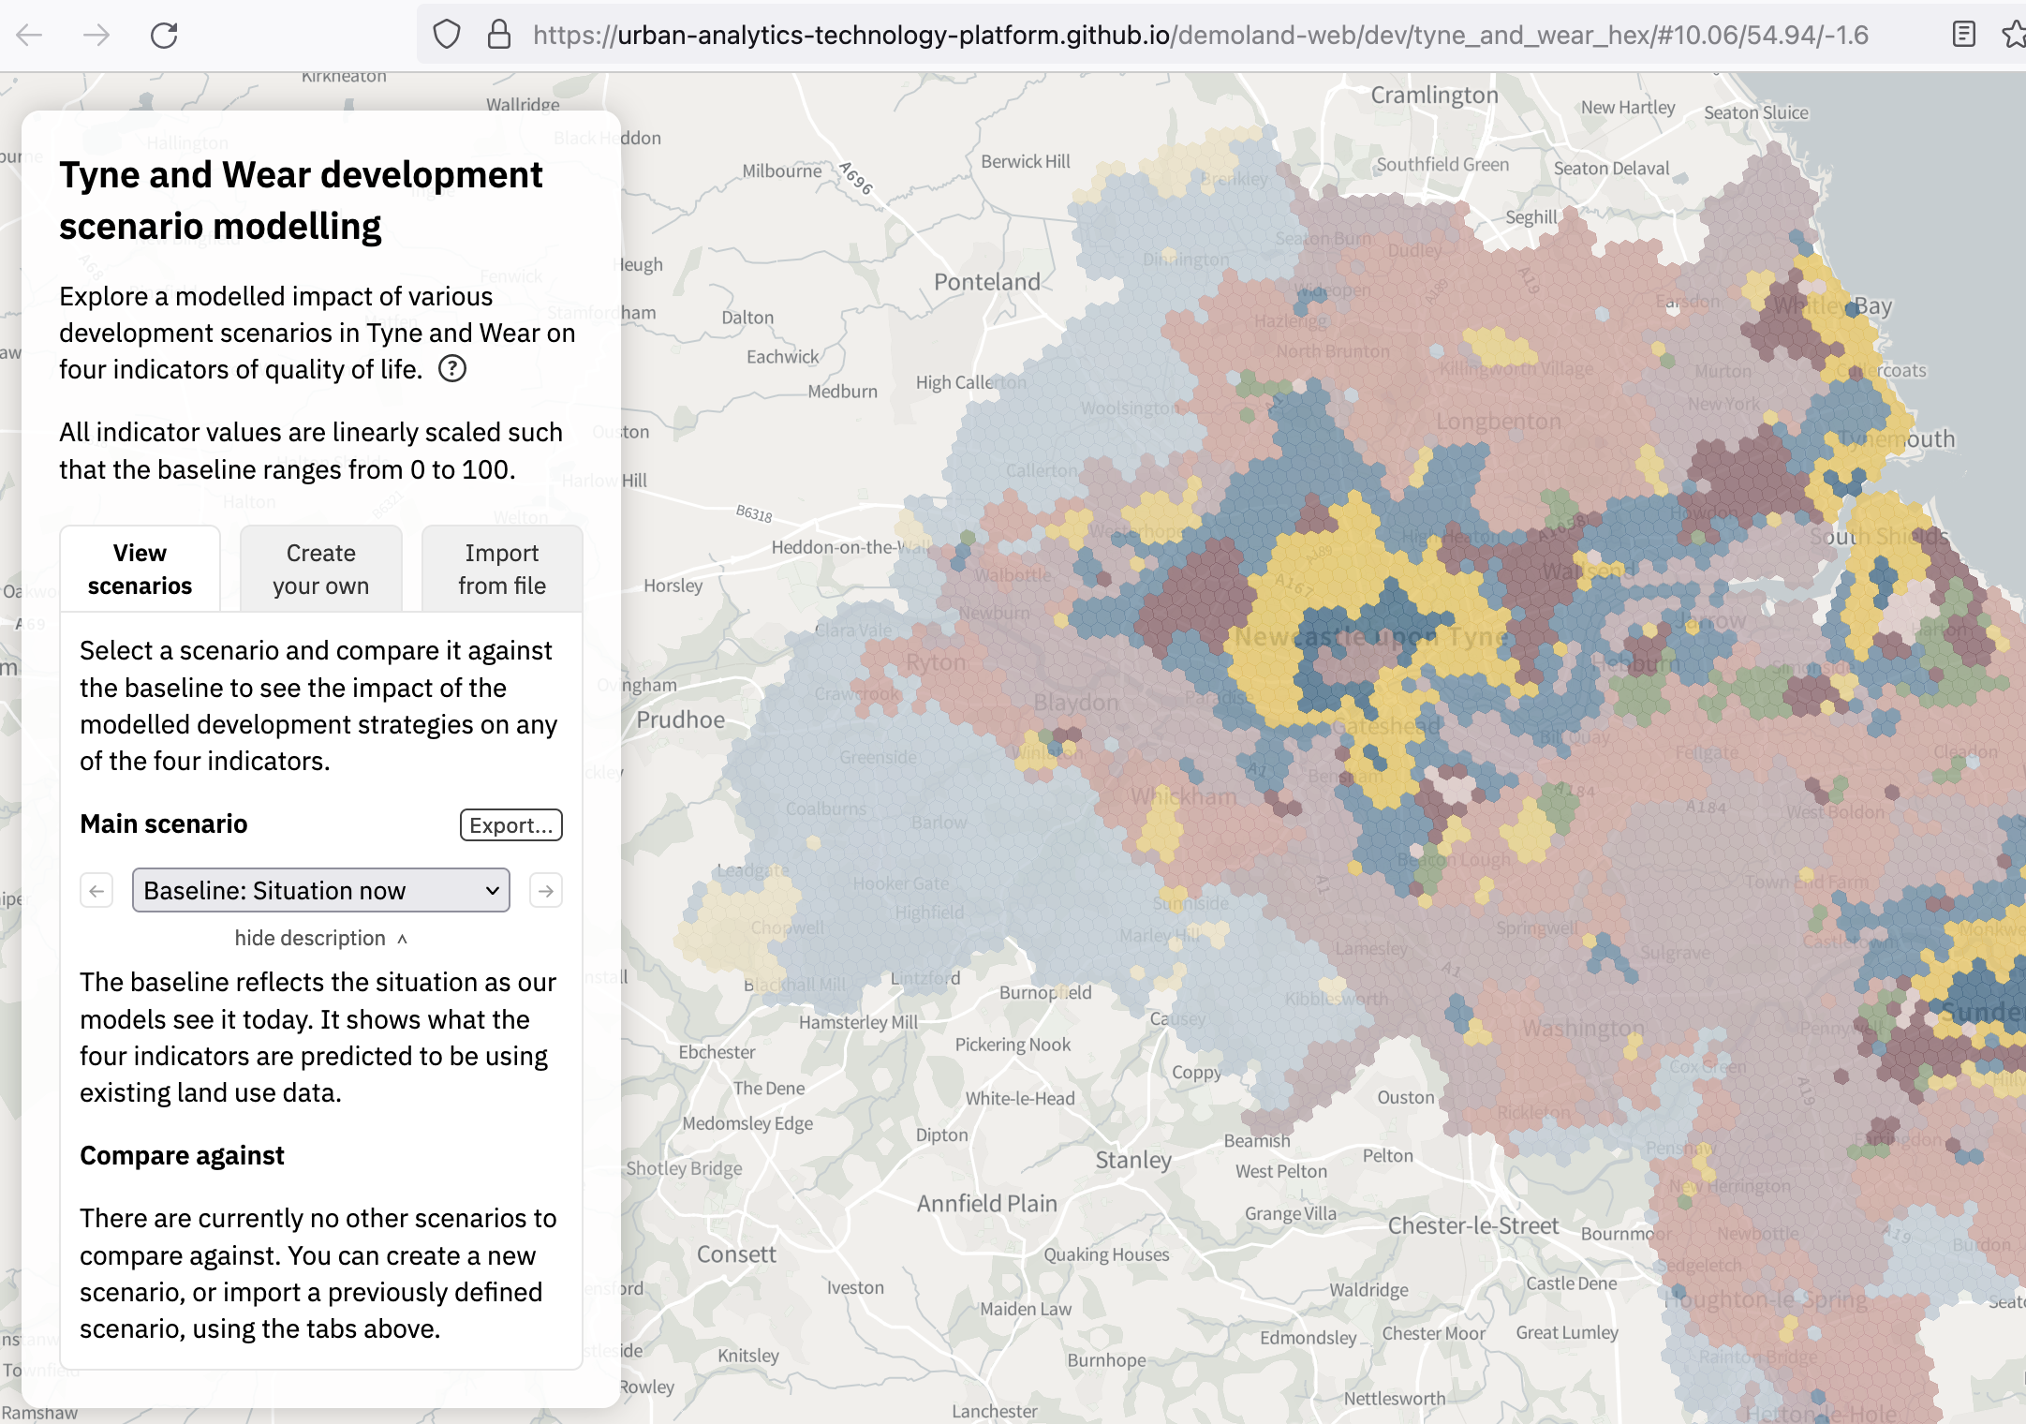
Demoland
Spatial modelling for (urban) land management predicting the impact of large-scale planning and land use changes
Urban-analytics-technology-platform.github.io/demoland-web
Notes:
Work based on larger project

Slide 12
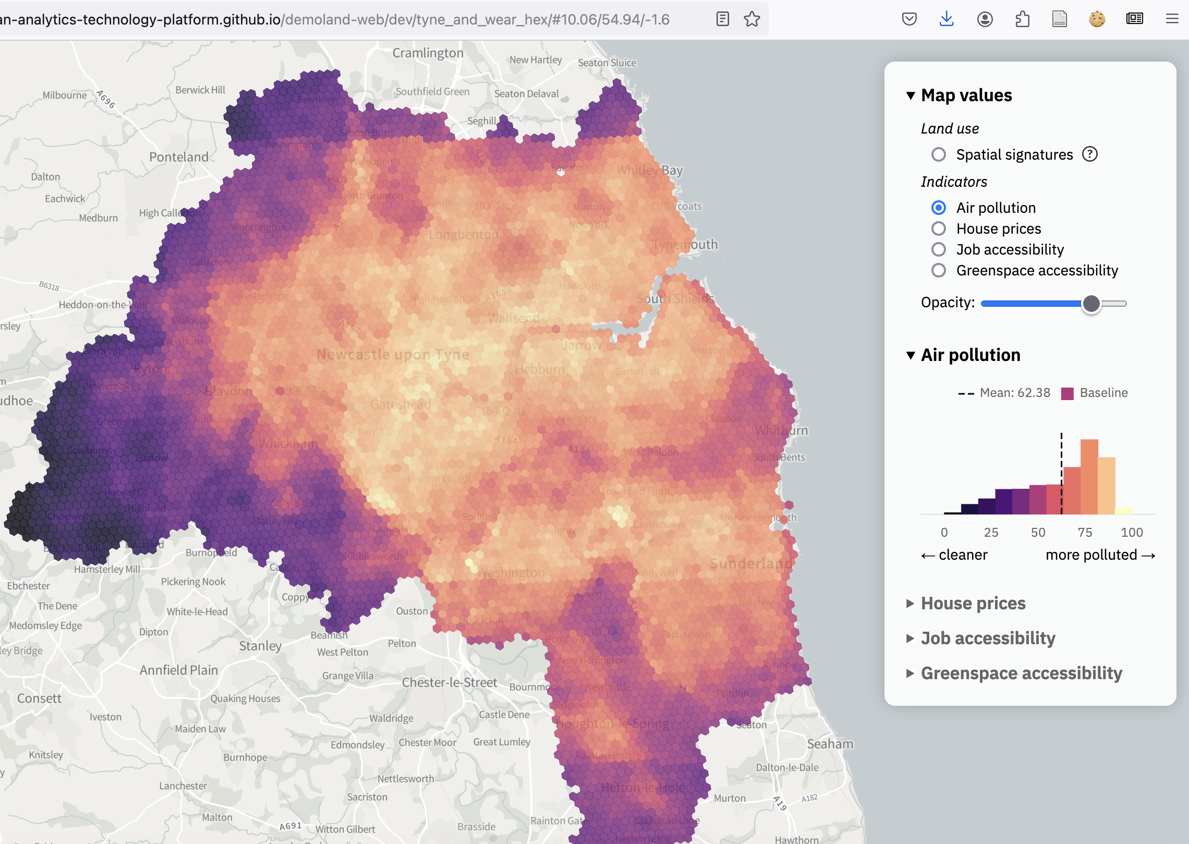
Demoland
Air pollution
Urban-analytics-technology-platform.github.io/demoland-web

Slide 13
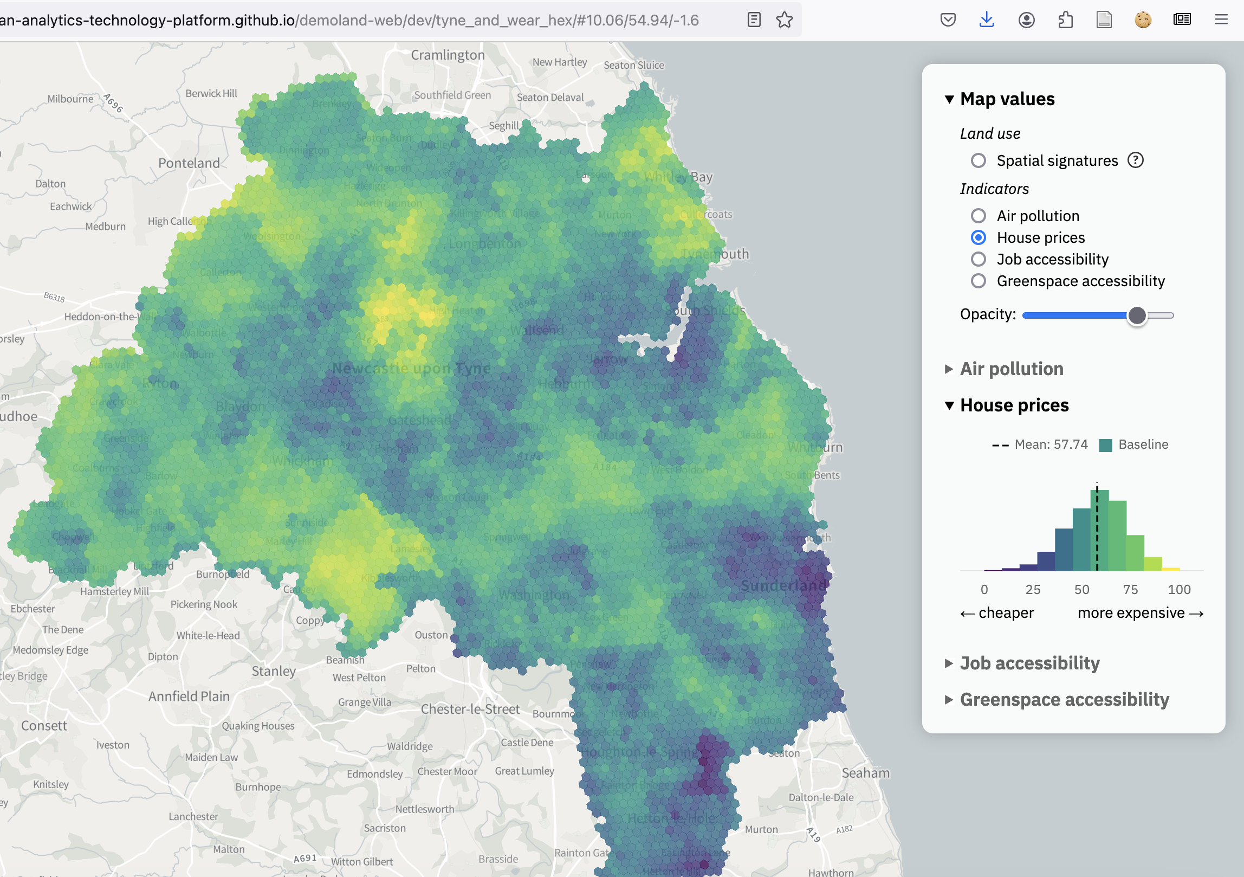
Demoland
House prices
Urban-analytics-technology-platform.github.io/demoland-web

Slide 14
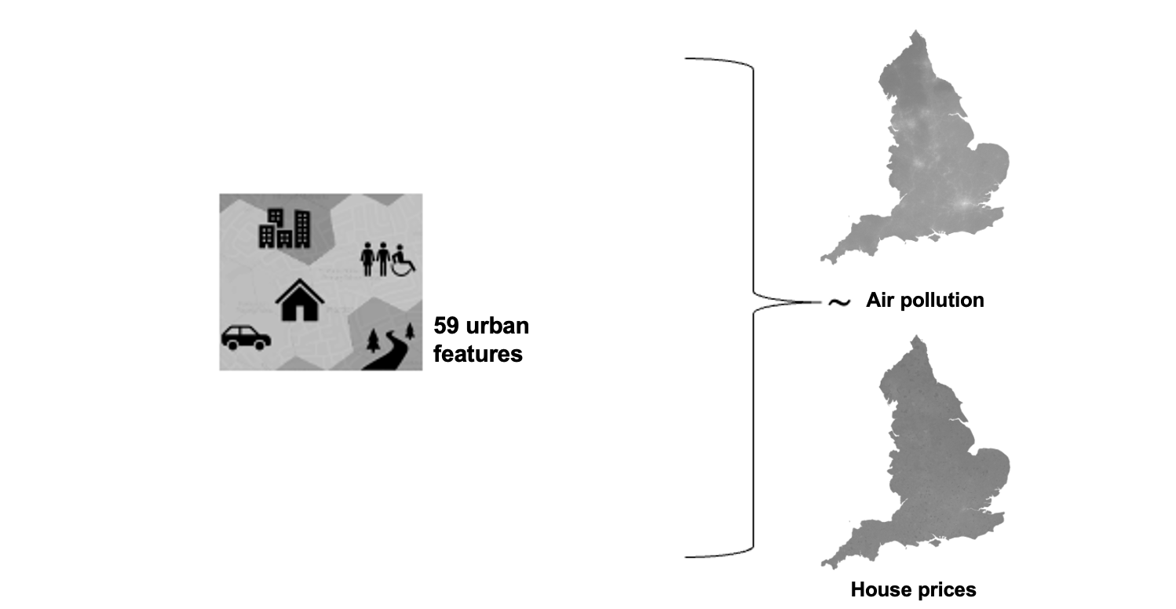



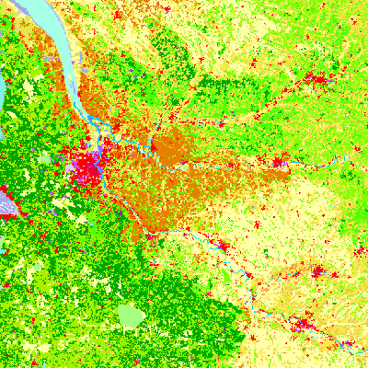
Demoland
Modelling approach
Notes:
Data sandwich
Yet, very difficult to put it all together because of different spatial/temporal resolutions.
Census only collected every 10 years

Slide 15
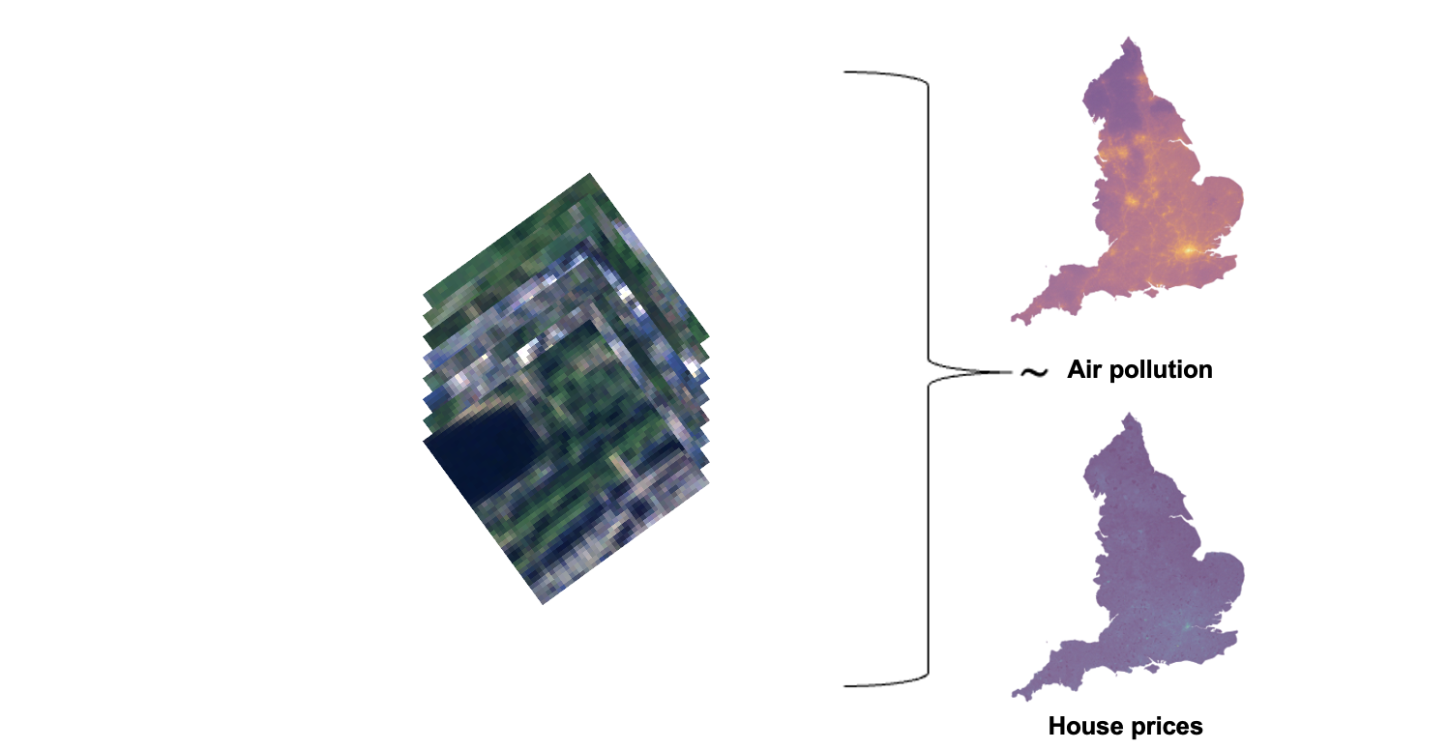
Demoland 2.0
Could we just use satellite images?
Notes:
Data sandwich

Slide 16
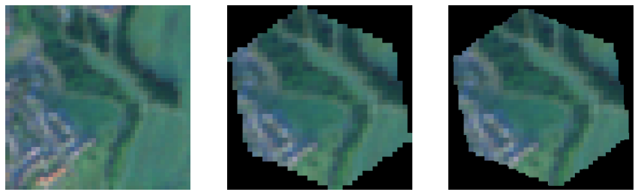
Satellite images
Satellite composite (Sentinel-2), RGB, 10m/px, 2018/19
420 x 420 m (H3, level 9)
unmasked
masked
summed masked
Notes:
Data sandwich

Slide 17
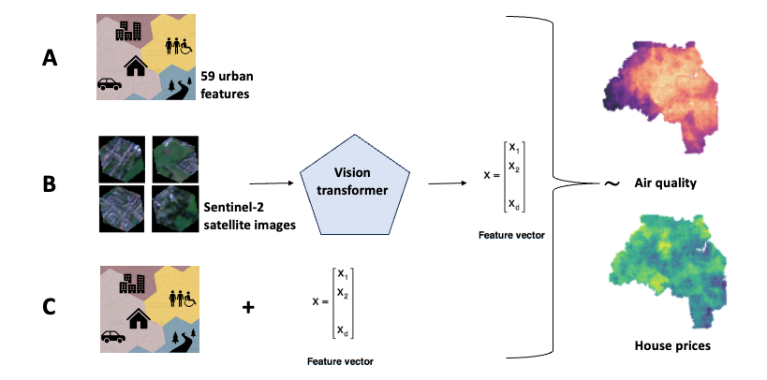

Experiment setup
Baseline
59 urban features
Air pollution
Sentinel-2
Satellite images
Embeddings
Embeddings
House prices
Notes:
Data sandwich

Slide 18
Experiment setup
59 urban features
Air pollution
Satellite embeddings
Sentinel-2
Satellite images
Embeddings
Embeddings
House prices
Notes:
Data sandwich

Slide 19
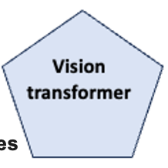
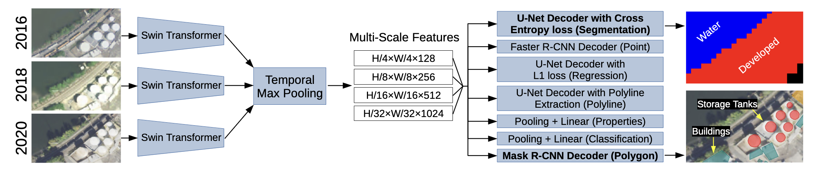
SatlasNet: Foundation model
Image embeddings: [n x 128]
Notes:
Data sandwich

Slide 20
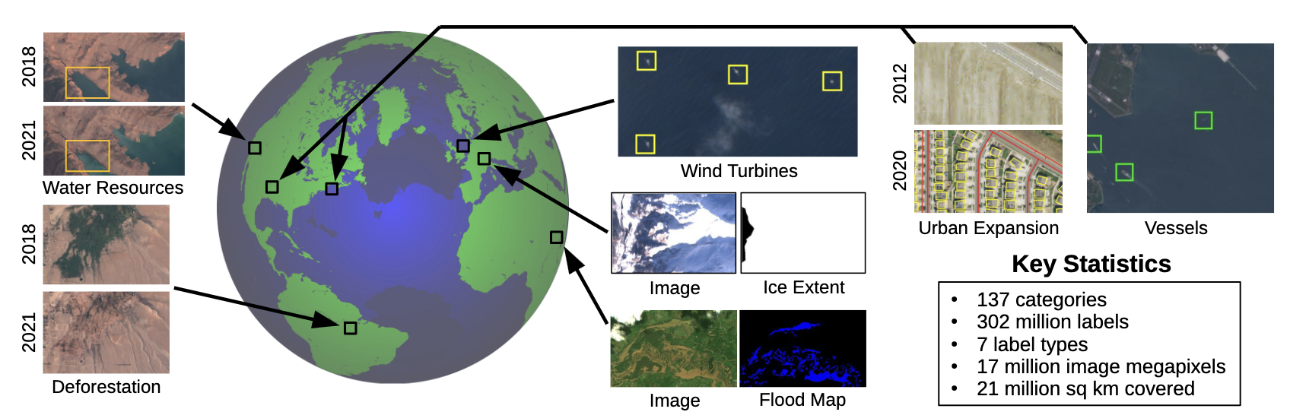
Satlas Pretrain
Labelled Sentinel-2 images
SatlasPretrain: A Large-Scale Dataset for Remote Sensing Image Understanding, Bastani et al., ICCV, 2023
Notes:
Data sandwich

Slide 21

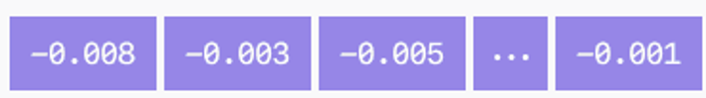
Image embeddings
No fine-tuning
Sentinel-2 RGB
FM
Image
Image as vector

Slide 22
Experiment setup
59 urban features
Air pollution
Sentinel-2
Satellite images
Embeddings
Urban features and embeddings
Embeddings
House prices
Notes:
Data sandwich

Slide 23
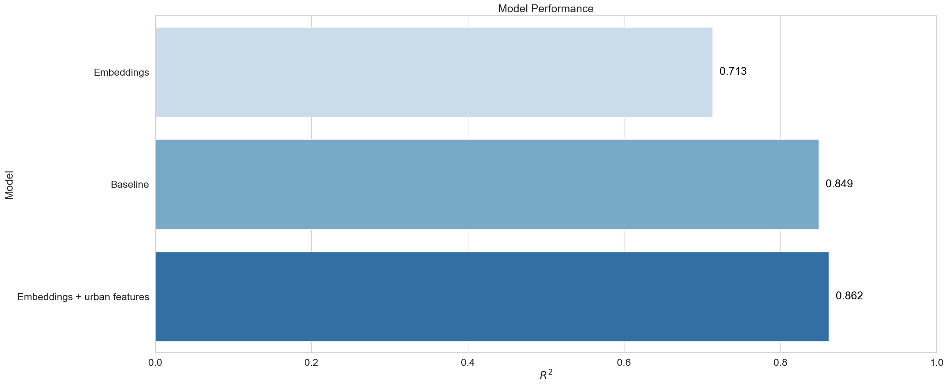
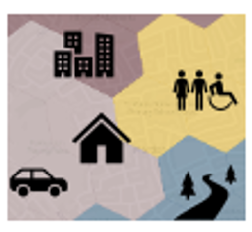
Results: Air pollution (R²)

Slide 24
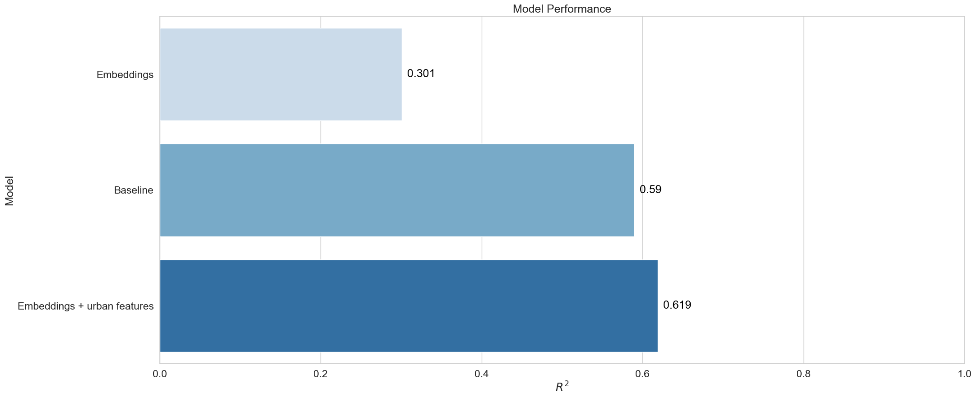
Results: House prices (R²)

Slide 25

Accounting for regional trends
+
Baseline
59 urban features
+
Air pollution
Satellite embeddings
Sentinel-2
Satellite images
Embeddings
+
+
Urban features and embeddings
Embeddings
House prices
Notes:
Data sandwich

Slide 26
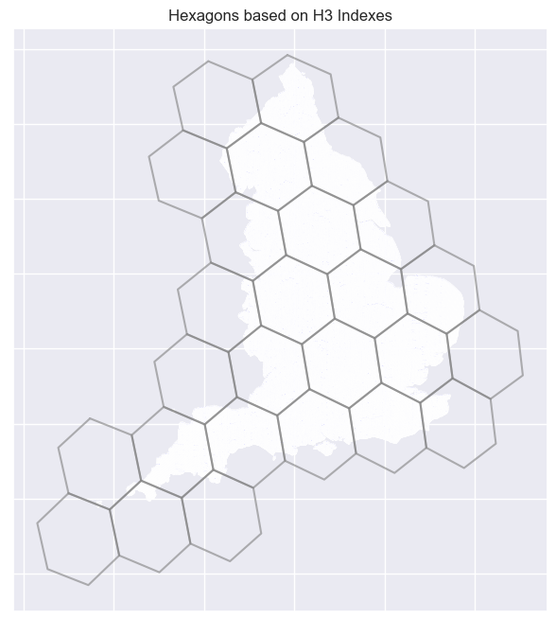
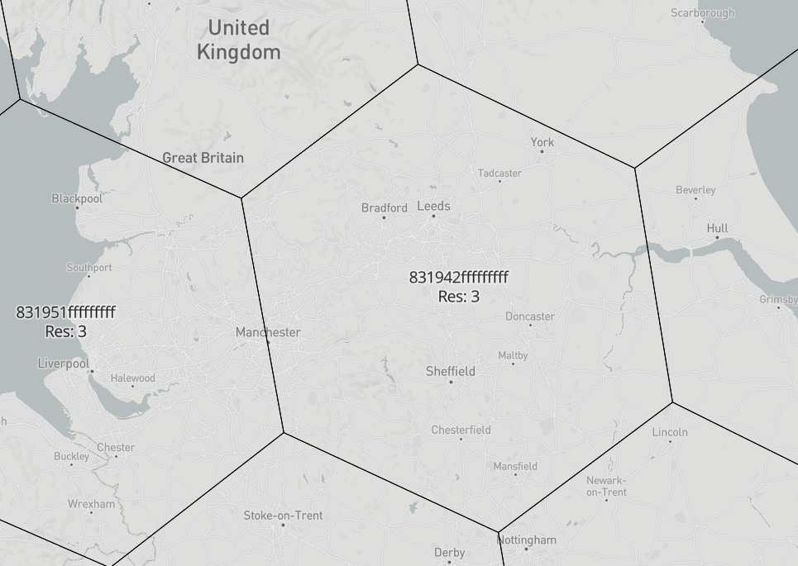
H3, level 3
Notes:
12,393.434655088 km^2
~ 117,660 in one

Slide 27
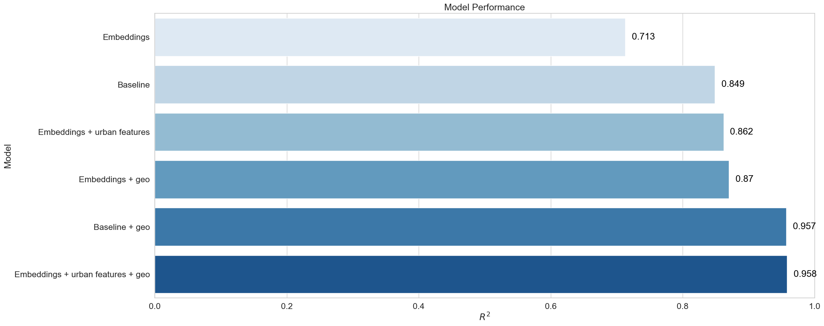
Results: Air pollution (R²)

Slide 28
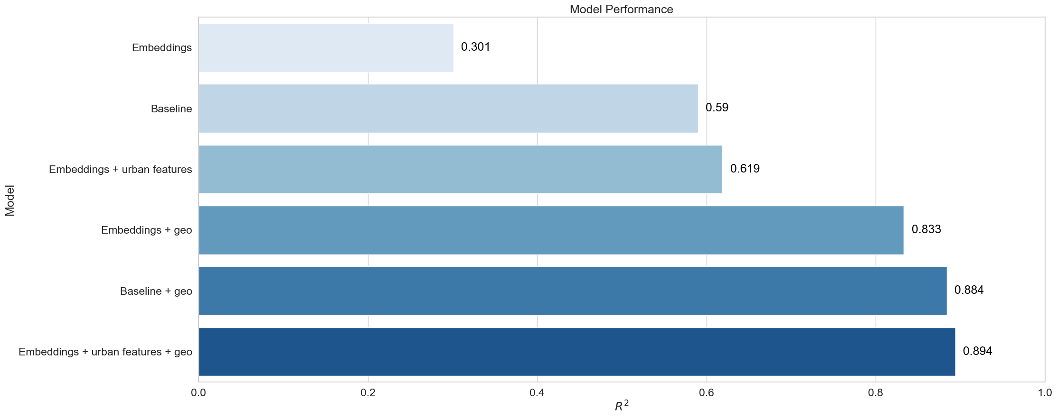
Results: House prices (R²)

Slide 29
Key lessons (part 1)
Foundation models are powerful tools for extracting image embeddings
Embeddings (of openly available satellite images) are useful for various tasks
Sometimes less can be more!

Slide 30
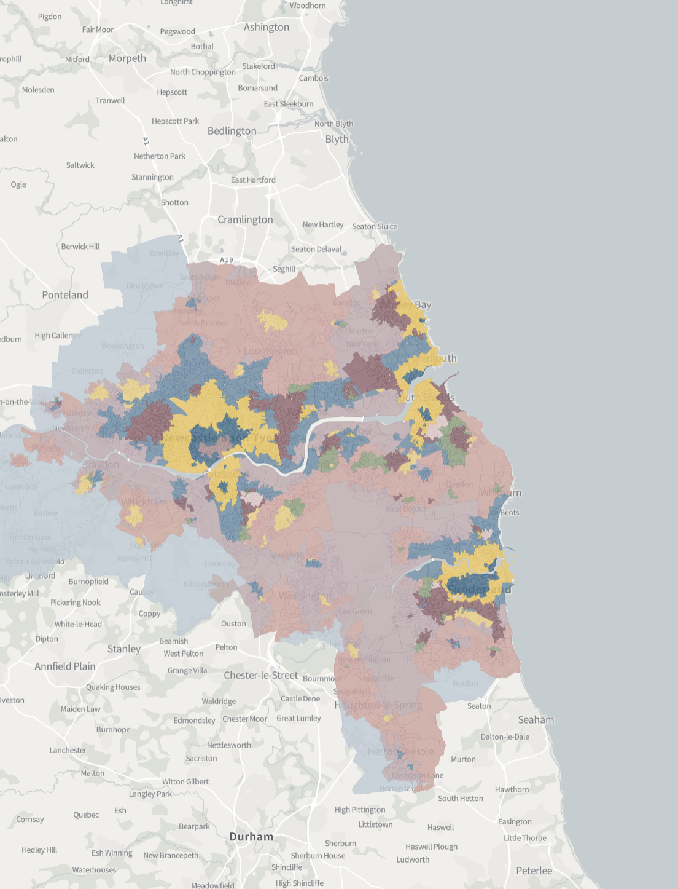
Would this work to predict spatial signatures?
Notes:
Requires a lot of data

Slide 31
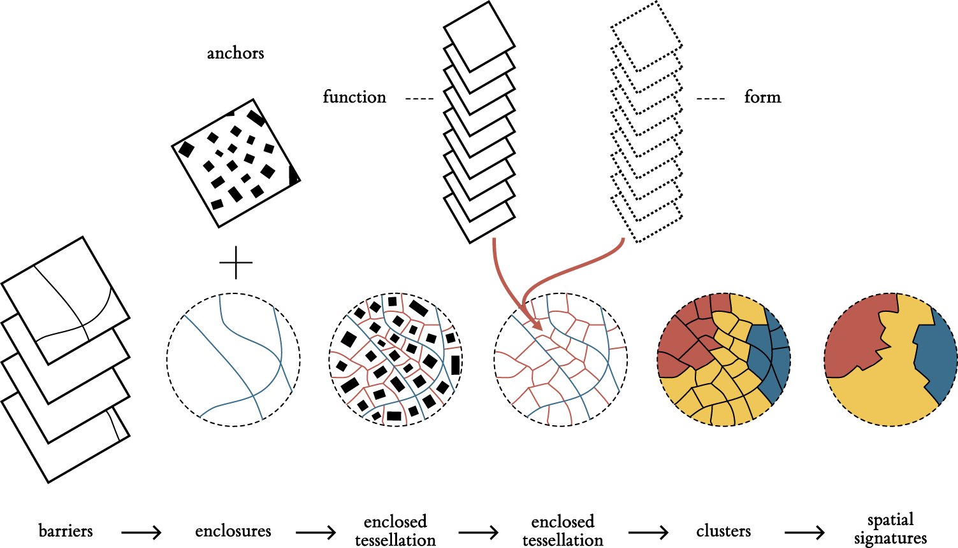
Spatial signatures
Martin Fleischmann, and Daniel Arribas-Bel. "Geographical characterisation of British urban form and function using the spatial signatures framework." Scientific Data 9.1 (2022): 546.

Slide 32
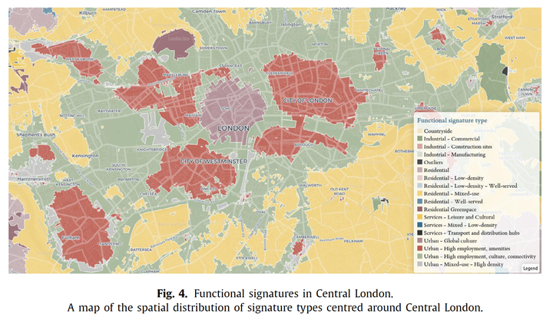
Martin Fleischmann, and Daniel Arribas-Bel. "Geographical characterisation of British urban form and function using the spatial signatures framework." Scientific Data 9.1 (2022): 546.

Slide 33
Classification vs segmentation

Slide 34
Model comparison (Spatial signatures)
A Classification (two-step): Satlas embeddings + XGBoost
B Segmentation (one-step): FM finetuned
C Classification (one-step): FM finetuned

Slide 35
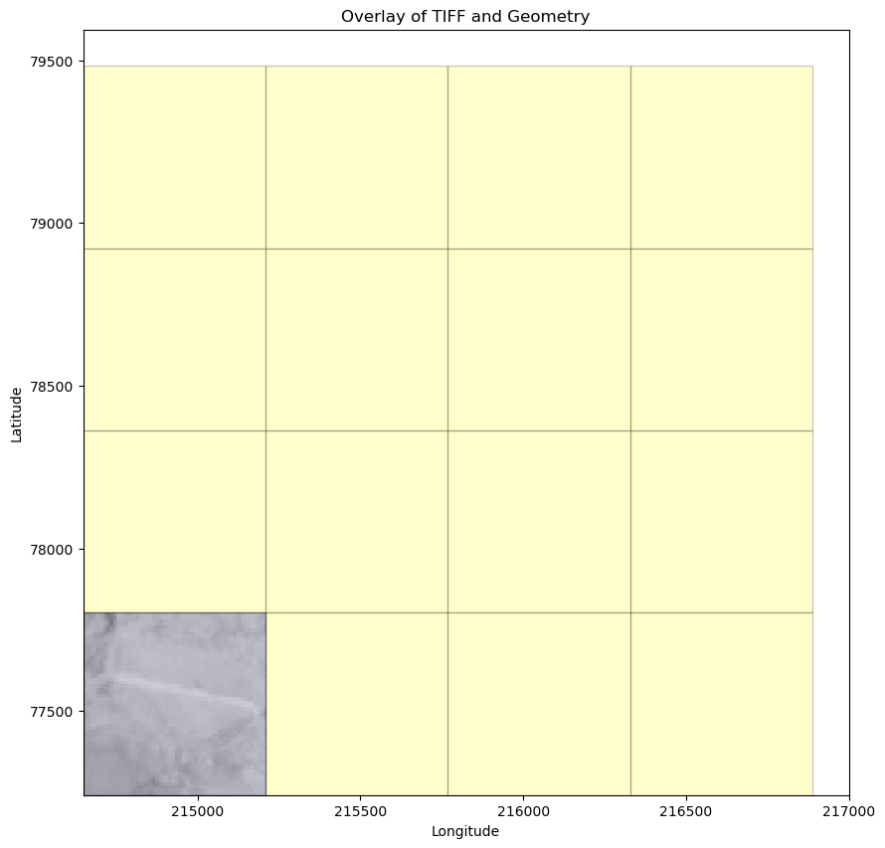
Data prep
Classification: 56 x 56 px
Segmentation: 224 x 224 px

Slide 36
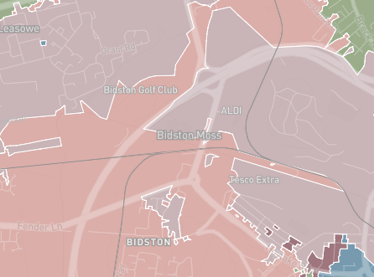
Sampling

Slide 37
Sampling
Compare only tiles strictly within spatial signatures

Slide 38
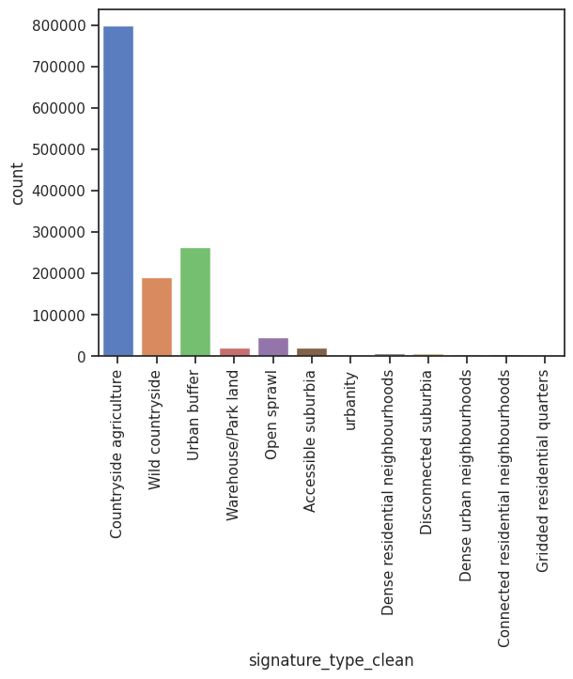
Datasets: train/test split (80/20%)
224 x 224px (2240x2240m)
Total: 26,753
Train: 21,402
Test: 5,351
56 x 56px (560x560m)
Total: 403,722
Train: 342,648
Test: 61,074

Slide 39
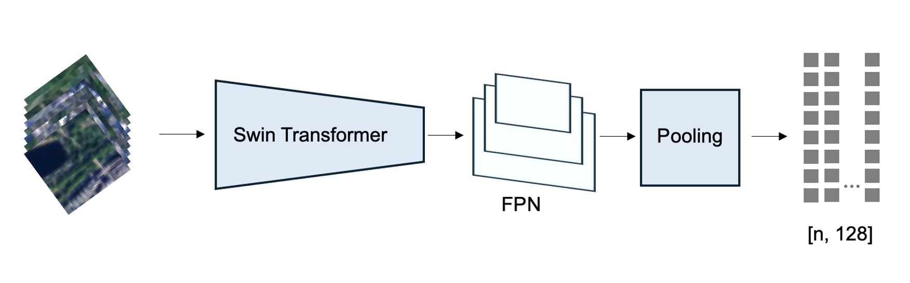
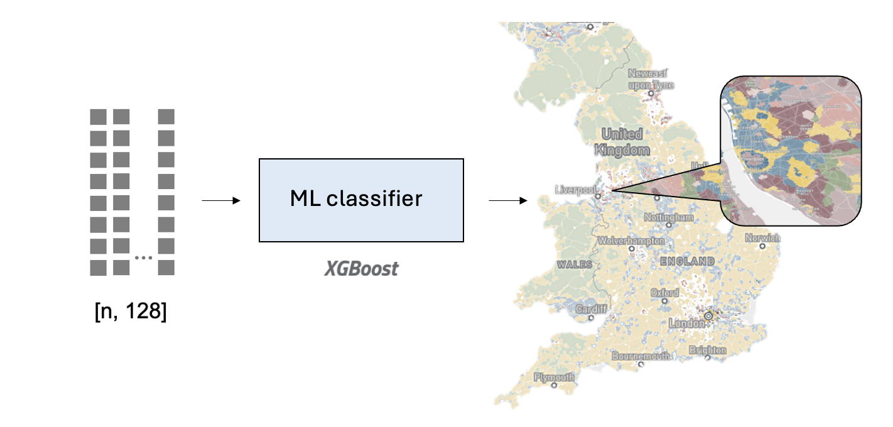
A Embeddings model: Classification (two-step)
1.
2.

Slide 40



B Foundation models for EO
SatlasPretrain
Clay
IBM/NASA
Notes:
Allen institute
Stanford

Slide 41
B Experiment set-up (segmentation)
Data preprocessing
Non-overlapping tiles (224 x 224)
Random GeoSampler
Backbone
Satlas
Clay
Prithvi
Segmentation head
[Conv3x3 + relu] → Conv3x3
Loss
Cross-entropy
Validation metric
Accuracy (weighted)
IoU (weighted)
F1 (weighted)
Conv1x1 → Conv1x1
Focal
[Conv3x3 + relu] → [Conv3x3 + relu] → Conv1x1

Slide 42
B Experiment set-up (segmentation)
Data preprocessing
Non-overlapping tiles (224 x 224)
Random GeoSampler
Backbone
Satlas
Clay
Prithvi
Segmentation head
[Conv3x3 + relu] → Conv3x3
Loss
Cross-entropy
Validation metric
Accuracy (weighted)
IoU (weighted)
F1 (weighted)
Conv1x1 → Conv1x1
Focal
[Conv3x3 + relu] → [Conv3x3 + relu] → Conv1x1

Slide 43
B Experiment set-up (segmentation)
Data preprocessing
Non-overlapping tiles (224 x 224)
Random GeoSampler
Backbone
Satlas
Clay
Prithvi
Segmentation head
[Conv3x3 + relu] → Conv3x3
Loss
Cross-entropy
Validation metric
Accuracy (weighted)
IoU (weighted)
F1 (weighted)
Conv1x1 → Conv1x1
Focal
[Conv3x3 + relu] → [Conv3x3 + relu] → Conv1x1

Slide 44
B Models implemented: segmentation
 | Satlas | Clay | Prithvi
Run time (per epoch) | 31 mins | 11 mins | ~60 mins
Ease of implementation/ adding changes | 5/10 | 6/10 | 7/10
Hyperparameter experiments/ tracking | Own set up | Wandb.ai | Tensorboard
Accuracy | ~57% | ~60% | ~62%
IoU (weighted) (0-1) | ~0.33 | ~0.58 | ~0.32
F1 (weighted) | ~0.41 | ~0.69 | ~0.42
No hyperparameter tuning!
Notes:
Table with baseline
Comparison on tile/pixel level - pixel level -
Runtime column
Focal loss satlas

Slide 45
C Models implemented: classification
Clay – finetuned
Smaller tiles
 | Clay
Run time (per epoch) | 20 mins
Ease of implementation/ adding changes | 6/10
Hyperparameter experiments/ tracking | Wandb.ai
Accuracy | ~68%
IoU (weighted) (0-1) | ~0.50
F1 (weighted) | ~0.52

Slide 46
RESULTS overview
Pixel level accuracy scores (test set)/ strictly overlapping tiles
Tile level accuracy scores in brackets (for classification only)
Model | Global Accuracy | MACRO accuracy | F1 score (balanced) | IoU (balanced)
A Classification (embeddings) | 0.76 (0.66) | 0.22 (0.13) | 0.23 | 0.63
A Classification (embeddings) + h3 level 5 | 0.87 (0.82) | 0. 42 (0.35) | 0.45 | 0.79
C Classification (Clay) | 0.59 (0.68) | 0.09 | 0.12 | 0.38
B Segmentation (Clay) | 0.73 | 0.31 | 0.30 | 0.58

Slide 47

Comparison Clay models (B+C)
Ground truth
Segmentation (B)
Classification (C)
Access sub. Connected res. Countryside agri Dense resi. Dense urban Discon. Sub. Gridded resi Open sprawl Urban buffer Urbanity Warehouse/park Wild country
Notes:
0: "Accessible suburbia",
1: "Connected residential neighbourhoods",
2: "Countryside agriculture",
3: "Dense residential neighbourhoods",
4: "Dense urban neighbourhoods",
5: "Disconnected suburbia",
6: "Gridded residential quarters",
7: "Open sprawl",
8: "Urban buffer",
9: "Urbanity",
10: "Warehouse/Park land",
11: "Wild countryside"
}

Slide 48
Urban applications across England (recap)
Air pollution
House prices
Spatial signatures
Fleischmann and Arribas-Bel. "Geographical characterisation of British urban form and function using the spatial signatures framework." Scientific Data 9.1 (2022): 546.

Slide 49
Some work better than others! (recap)
0.71
Air pollution
R²
0.87
0.30
House prices
R²
0.83
0.76 (0.22)
Spatial signatures
Accuracy (balanced)
0.87 (0.42)
Notes:
250km^2
Reegional context

Slide 50
Key lessons
Some tasks are better suited for FM tasks than others?
Clear visual signals
Adding regional context can be helpful!
Notes:
Intuitive results

Slide 51



Thank you!
bmetzler@turing.ac.uk
@barbarametzler

Slide 52
Appendix

Slide 53
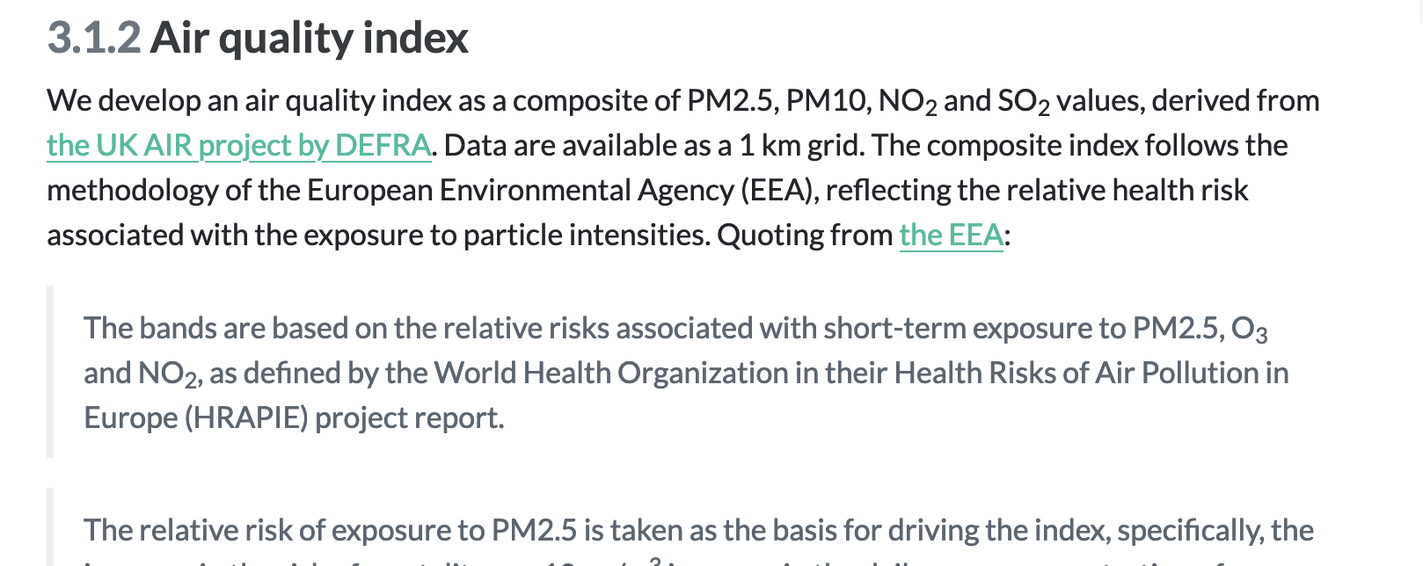

Slide 54
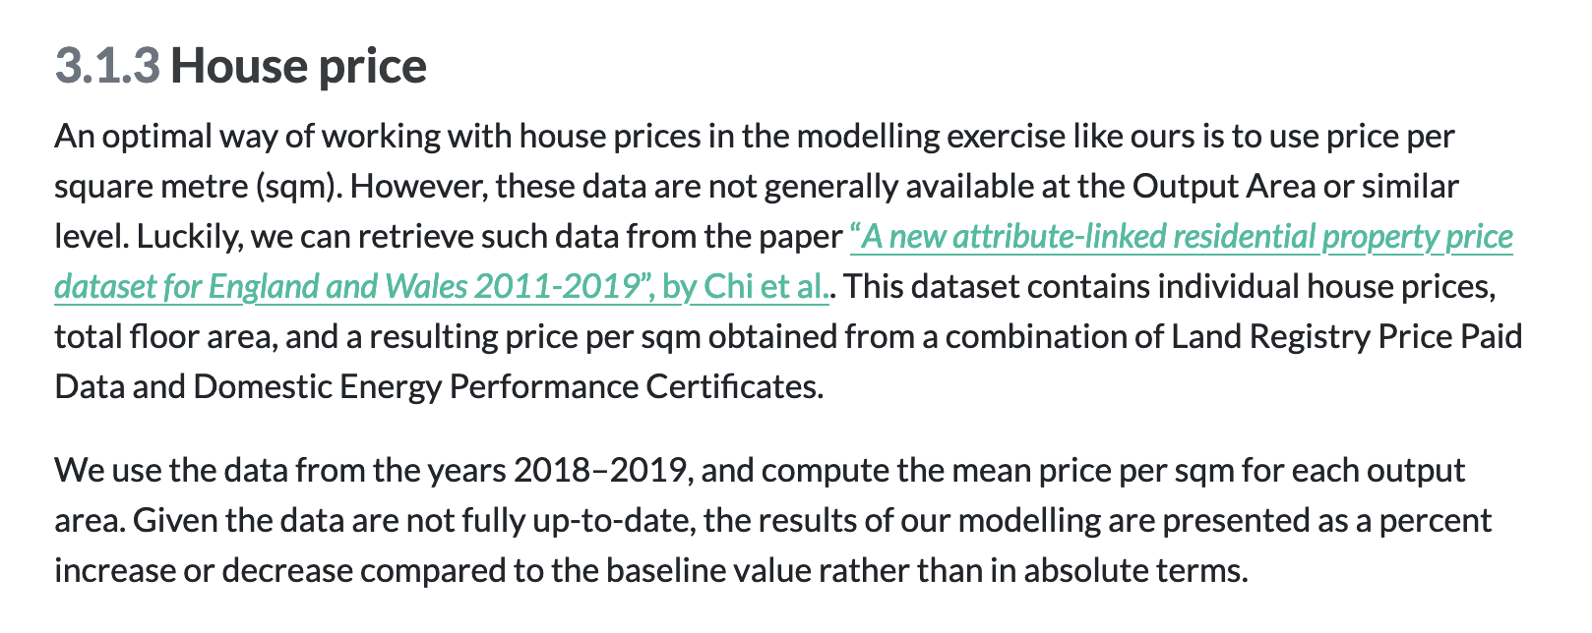

Slide 55
